Slide 1

z/OS DevOps End-to-End Overview Executive Summary
Nelson Lopez
Z DevOps Transformation Specialist
Nelson.lopez1@ibm.com

Slide 2
Topics
Quick Overview (Concepts)
DevOps on Z
Continuous Integration / Continuous Deployment (CI/CD)
Git for Z
IBM’s Dependency Based Build Tool (DBB)
Urban Code Deploy for Z
Demo (Nazare CI Flow)
Getting Started with the DevOps Acceleration Team

Slide 3
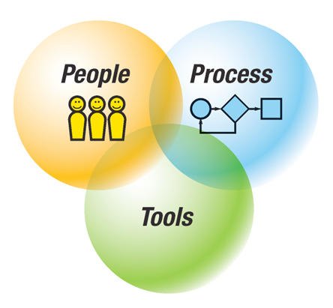
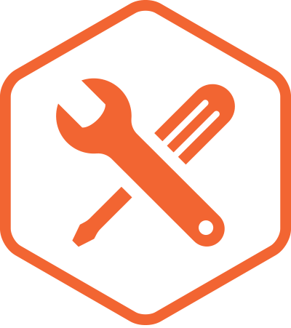


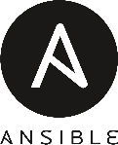


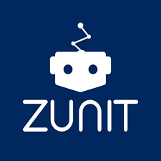
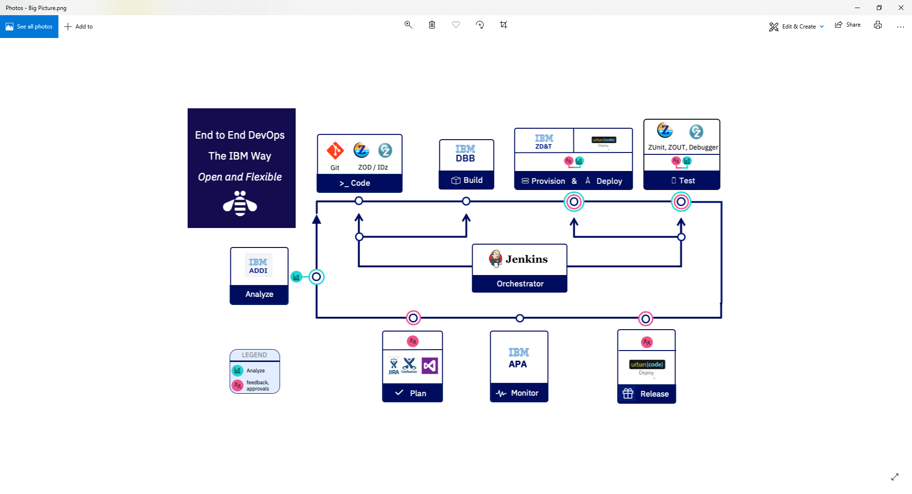

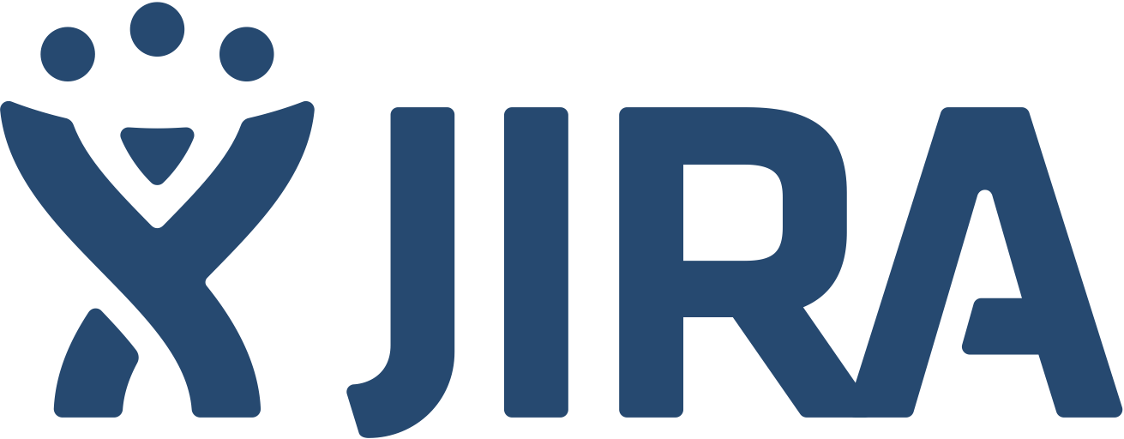

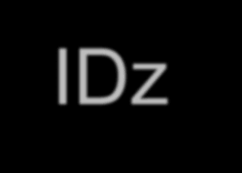
IBM Z DevOps → The Value Proposition is Strong
ENTERPRISE WIDE STANDARDIZATION
AUTOMATION
Platform neutral, continuous integration and deployment pipeline across the enterprise. Uniform enterprise wide agile delivery processes and standards facilitates transferable skills
Powerful and automated unit testing as part of a continuous delivery pipeline
50-90% time savings on test cycles²
MODERN DEVELOPMENT PRACTICES
SKILLS AVAILABILITY
Advanced Application Intelligence, Modern development IDEs to empower the next generation of developers.
20-50% productivity benefits for typical development tasks¹
#2 on Glassdoor’s 50 best Jobs in America Rankings and one of the Top 5 Technical Skills Growth areas
OPEN TOOL CHAIN
Notes:
1.Source – Validated customer feedback
2. Source - https://dzone.com/articles/the-roi-of-automated-testing
3.Accelerate State of DevOps Report 2018
4. GitLab 2018 Global Developer Report. (n.d.). Retrieved from https://about.gitlab.com/developer-survey/2018/
5. https://www.ibm.com/account/reg/us-en/signup?formid=urx-17749
6. https://www-01.ibm.com/common/ssi/cgi-bin/ssialias?htmlfid=65014265USEN&
Combining Agile and DevOps practices can make it easier to build open and hybrid applications. DevOps is the union of People, Process, and Tools to enable continuous integration and continuous delivery to our clients
People – we need to ensure that everybody delivering value to the business is working tightly together on the common goal of adding value for the customer.
Process- DevOps is about improving processes because even if you have highly motivated people that are working well together, you may still have several business processes which may get in the way, and this could really block innovation.
Tools – There are products, tools, and services that can help enable different DevOps practices and different teams which can be used to make things easier.
But even with the best tools, DevOps is just another buzzword if you don’t have the right culture.
The primary characteristic of DevOps culture is increased collaboration between the roles of development and operations. There are some important cultural shifts, within teams and at an organizational level, that support this collaboration
It IS possible and you CAN transform your zOS environment to a true, modern DevOps practice. There is nothing about Z that stops you from doing DevOps. We can bridge the gap between mainframe and distributed by bringing modern SCMs, modern parallel development and by letting developers work in mainframe and distributed worlds in the same way.
IBM’s end to end cross-platform delivery pipeline solution integrates with a variety of open source and third party tools allowing you to balance between open source and enterprise tooling to choose a pipeline that is right for your organization based on business needs.
Some of the open source and third party integrations that we offer are listed at the bottom of the slide – including GIT, Jira, Jenkins, SonarQube to name a few.
We want to focus on a common tooling across the development process. And outside of mainframe development, Git has become the defacto standard for source control in application development.
IBM Z Open Development is an ecosystem of capabilities that enables developers to get the most out of a modern SCM like Git and standardizing on true parallel development across the enterprise. ZOD helps you to work with mainframe application source that is stored in Git. It also include Dependency Based Build – which allows you to have a build took kit which you can use to build your applications and analyze the dependences required for build. DBB also includes Groovy for automation so it actually helps you to bring your mainframe processes into the world of open source so you can hook up your mainframe processes to CI/DC to open source tools like Jenkins. In a nutshell, ZOD is a full set of capabilities that allow you to accelerate devops.
Other common tooling to embrace DevOps include Jenkins to manage CI and CD workflows and this can be the same Jenkins master that is running your distributed workloads.
There is UrbanCode for deployment – again this can be the same Urban code that is used to deploy your distributed code into cloud environments and on prem environments
When we talk about deploying more changes faster, we need true parallel development that empowers the developer with autonomy for development and testing.
Automation
Continuous testing is a key part of DevOps and it means testing earlier in the life cycle, which results in reduced costs, shortened testing cycles, and continuous feedback on quality. This process of shift-left testing, stresses integrating development and testing activities to ensure quality is built-in as early in the life cycle as possible.
It’s important that the first step of the testing is done in a clean and automated way so you’re feeding in tested code into the rest of the lifecycle. And that’s why we’re investing in Unit Testing. Z Open Unit Test will be an advanced and flexible tool for writing and executing automated unit tests of programs on IBM Z.
Using ADDI, you can identify most essential test cases, redundant test cases and understand code coverage. So you use ADDI to determine what data sets need to be provisioned and can then use
(zD&T) for rapid provisioning. With zD&T, you have the ability to rapidly spin up and take down z/OS test environments on demand both on premise and in the cloud. It empowers development teams with autonomy to have their own test environment… which means you avoid issues of contending for resources or even contenting for capacity.
So When you combine the automated unit testing capabilities of Z Open Unit Test, application understanding capabilities of ADDI to facilitate targeted provisioning with zD&T, it becomes a game changer and can truly differentiate you when you’re striving for more agility with testing on the mainframe.
Another driving factor for common tools across the stack is that we need to attract the younger generations to this environment, we need to bring the current development practices to this environment. And we can do that by looking at the distributed pipeline and bring it to the Z platform. This allows for cross training developers on familiar tooling so they don’t need to learn mainframe specific tools.
Z is the most reliable platform you have in your organization – it’s the most modern platform you have in your organization – we need to take that platform and use it to its best value.
Industry leading security, speed and scale
When it comes to building our Hybrid applications, the right platform is essential for fast, secure and scalable transactions. IBM Hyper Protect Services brings continuous security and scalability so all data is encrypted in use, in flight and at rest. Blockchain in Z gives you 8.5xmore effective security than x86 and lets you deploy new apps 3x faster. IBM Blockchain Platform is now available to deploy on multi-cloud, including on-prem using IBM Cloud Private on Z.

Slide 4

The 6 core DevOps capabilities
Continuous Integration
Discover and unleash IBM Z through API’s
Improve speed and quality
Optimize Cost and Skills
{...}
$
Automated Testing
Bring your own IDE
Enterprise class discovery and intelligence
Enterprise wide standardization with an open pipeline
Dependency Based Build
On demand development and test environments
Notes:
IBM identifies 9 core competencies that have helped enterprises successfully navigate in their journey to cloud, and address challenges with Managing Hybrid cloud environments, drive resiliency and optimizing costs and skills. Maturity in the 9 core competencies also result in organizations break the silos and achieve AI driven Operations (aka AIOps). The 9 core competencies are
Monitor and analyze hybrid Infrastructure for health, availability, performance for the entire system and sub-systems, to help IT Operators proactively identify issues that can result in downtime or other performance issues.
Automate to improve quality of service with a single point of control and integrated workflow across provisioning and management of hybrid cloud platforms.
End-to-end Application visibility for application performance, for faster problem isolation and minimizing costly war rooms.
4. Enhance infrastructure resiliency by automating to respond to events / triggers and to guarantee continuous availability.
5. Ensure workload resiliency by ensuring faster time to recovery from batch workloads failures.
6. Proactively identify and resolve issues. Artificial Intelligence and Machine learning are paving the way for enterprises to detect anomalies in the system faster, and remediate them quickly before they even happen.
7. With the looming retirement for the Mainframe administrators, and the new generation of IT Operators coming onboard – it is critical to bridge the skill gaps quickly. Many next generation IT Operators aren’t familiar with the 3270 interfaces, and are more used to mobile apps or web browsers. Bridge skill gap is an important competency helping collaboration and bridging skill gap between the 2 generations of IT Operators
8. Optimize Workload performance helps enterprise leverage licensing models that align with the Hybrid Cloud e.g Tailor Fit Pricing and also identify and optimize performance issues impacting their costs.
9. Finally, enterprise must be able to Forecast the performance and capacity needs for their system, to deliver optimal customer experience while staying compliant.

Slide 5
CI Phase

Slide 6
What is
IBM’s Dependency Based Build (DBB)

Slide 7
DBB - A Modern Mainframe Build Tool
DBB enables modern automated mainframe Builds (no JCL, TSO/ISPF, Jes…)
Fully integrated with all modern pipeline orchestrators like Jenkins, Azure …
Integrated with modern IDE or SCM like IDz and Git (bring your own IDE)
Empower next Gen Developers by using “Familiar” toolchain (Git, IDE, Scripting…)

Slide 8


DBB’s Intelligent Build
Copybook1
Tracks Dependencies and changes between programs & copybooks to drive intelligent, efficient builds
PGM-A
Copybook2
PGM-B
Copybook3
PGM-C
Static Link

Slide 9
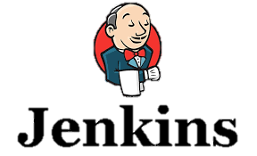





DBB Architecture
DBB WebApp
Dependency Metadata
Build Results History
3- Start
Pipeline
Server
z/OS
DB
Any Git Server
DBB Java Toolkit
2- Pull Request
Master Repository
CLONE to Z
MVS Java API’s
PDS
Agent
Local
repo
Groovy Build scripts
Compile
&
link
Scan, impact analysis, copy to PDS, compile, create artifacts, & report
1- Push
Run Groovy build script
Return status and Logs
Local Repo
USS
MVS
Desktop IDz

Slide 10
DBB Web Application
application dependency information
build reports
REST APIs access
DBB Toolkit
Java API Toolkit - Code scanner, metadata data interface, z/OS utils …
Groovy samples
Visit and contribute to our public DBB repo https://github.com/IBM/dbb

Slide 11
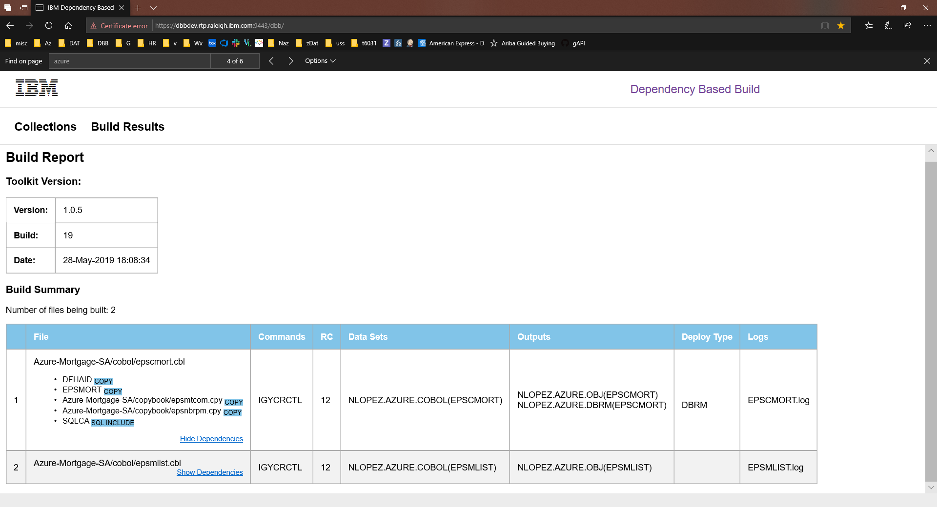

Slide 12
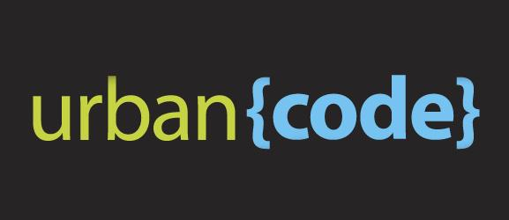
Continuous Deployment

Slide 13
CD Phase
Notes:
What we want to do is provide this pipeline as the automation framework for the DevOps transformation

Slide 14
Sample deploy.groovy flow
GIT
Urban Code Deploy
DBB
Build.groovy
Build
UCD Code Station
Component Versions
BuildReport.json
TARFILE
TARFILE
DBB
deploy.groovy
Package
TARFILE
TARFILE
Deploy
artifacts
TARFILE
TARFILE
artifacts
myapp.tar
artifacts
Load1, dbrm…
Shiplist.xml
BuzTool
Release
$LPAR=xyz
CICS – COPY LOAD
BATCH/CICS – COPY LOAD
DB2 BIND DBRM
NEWCOPY …
Continuous Integration
Continuous Deployment

Slide 15
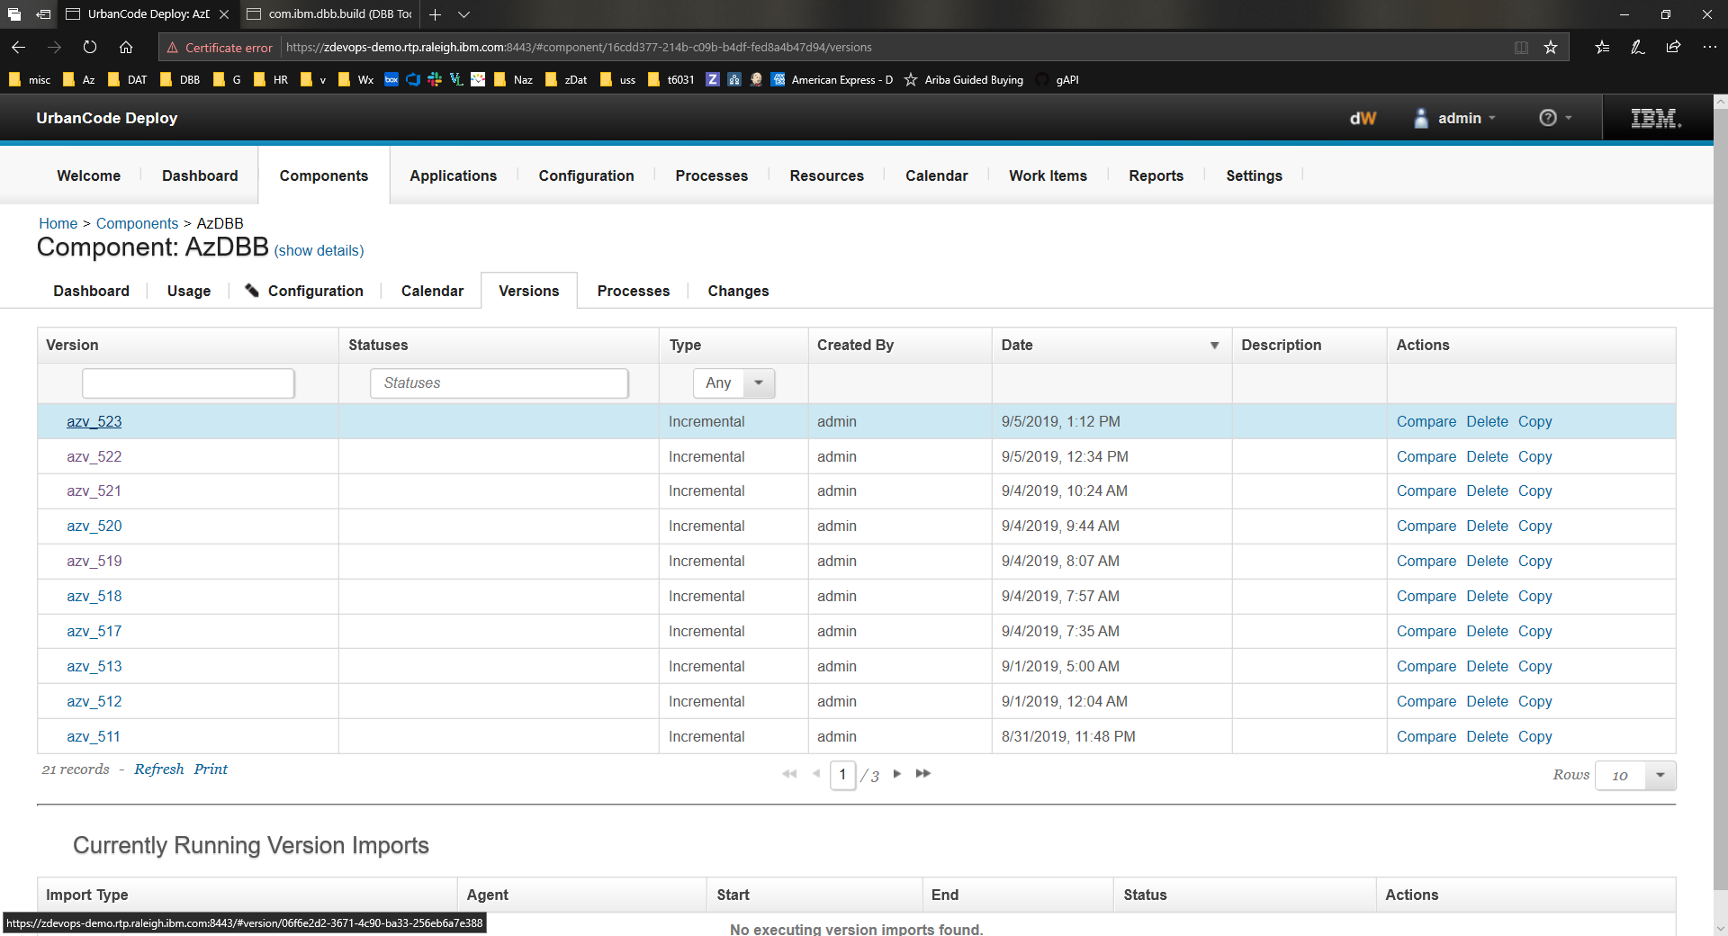
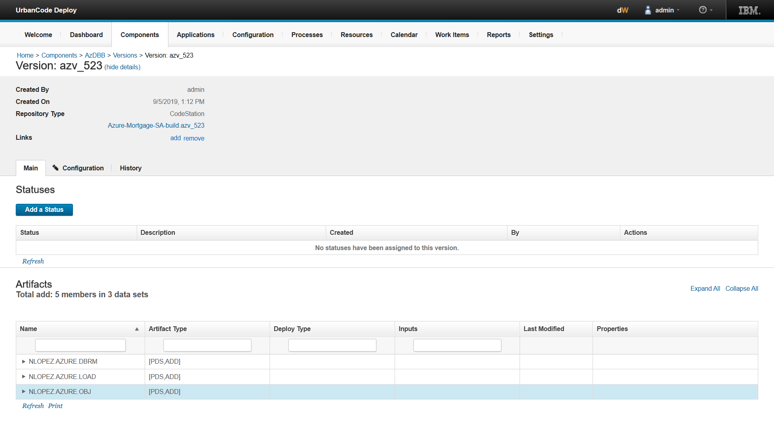
Urban Code Deploy
Artifact Store – Code Station
Artifact Store
Link to trace back to DBB Build Report for this release

Slide 16
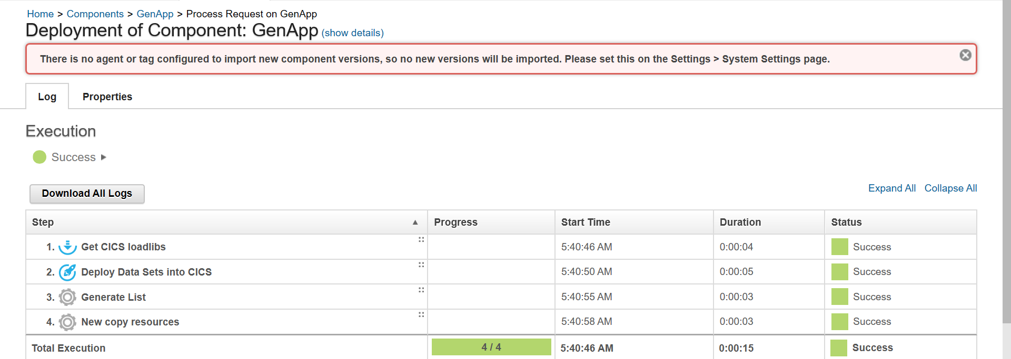
Deployment details
Deployment

Slide 17
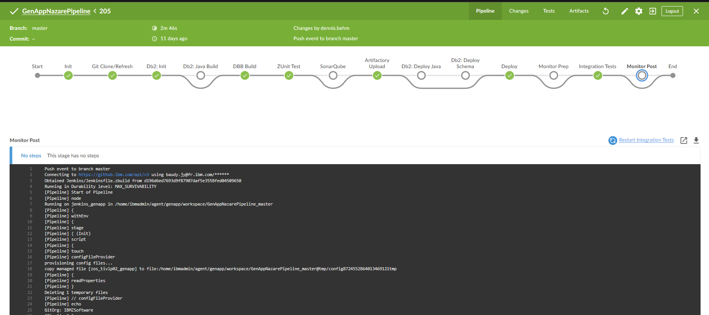
Run the Demo

Slide 18



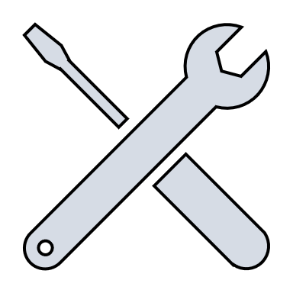


Summary - Modern z/OS Development with CI/CD
Analysis & Planning
Development Phase
Continuous Deployment
Developer
Sprints
CI - User Builds
Ops
. Automated Impact Analysis
. Code Checkout & packaging
. Automated Test environment buildout
Branch
Code
Commit
IDz
zUnit
Report
Build
QA …
PROD
Master
Git
Clones
Dev Repo
Pull Requests
zD&T
DBB
zUnit
Git Hub
Jenkins
Urban Code
Modern cross platform/distributed SCM, with audit trails and history
Features
CI - Team Build
Team
Repo
Admin
Lead
SIT
Report
Build`
Code Review
Approve
Merge
Modern Impact Discovery & Analysis with IBM “ADDI” & “DBB”. Automated environment buildout with IBM’s zD&T
Agile workflows supporting parallel and isolated developer sprints as well as integrated team builds
Stage
Deploy
Artifacts
Repo
DBB
zD&T
zUnit
Continuous Delivery
CI - Continuously Integrate new features with automated build, test and reporting. Use zD&T to provision an isolated test environment per developer/team.
(CD) Automated Delivery and Deploy, with versioning and fallback features

Slide 19
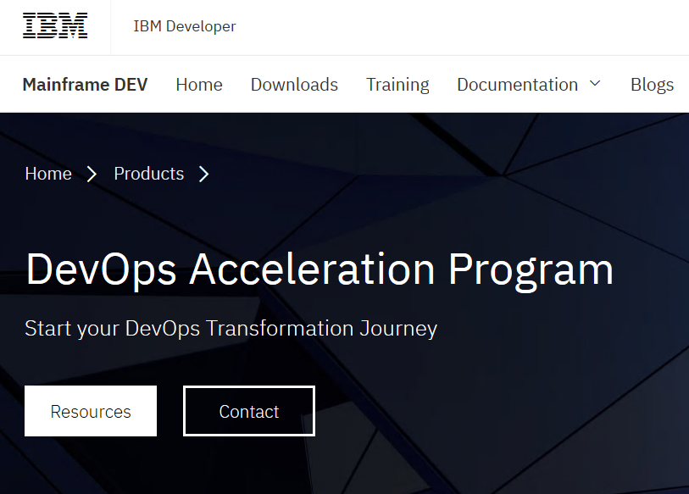
Getting started
IBM’s DevOps Acceleration Program
https://developer.ibm.com/mainframe/products/devops-acceleration-program/

Slide 20
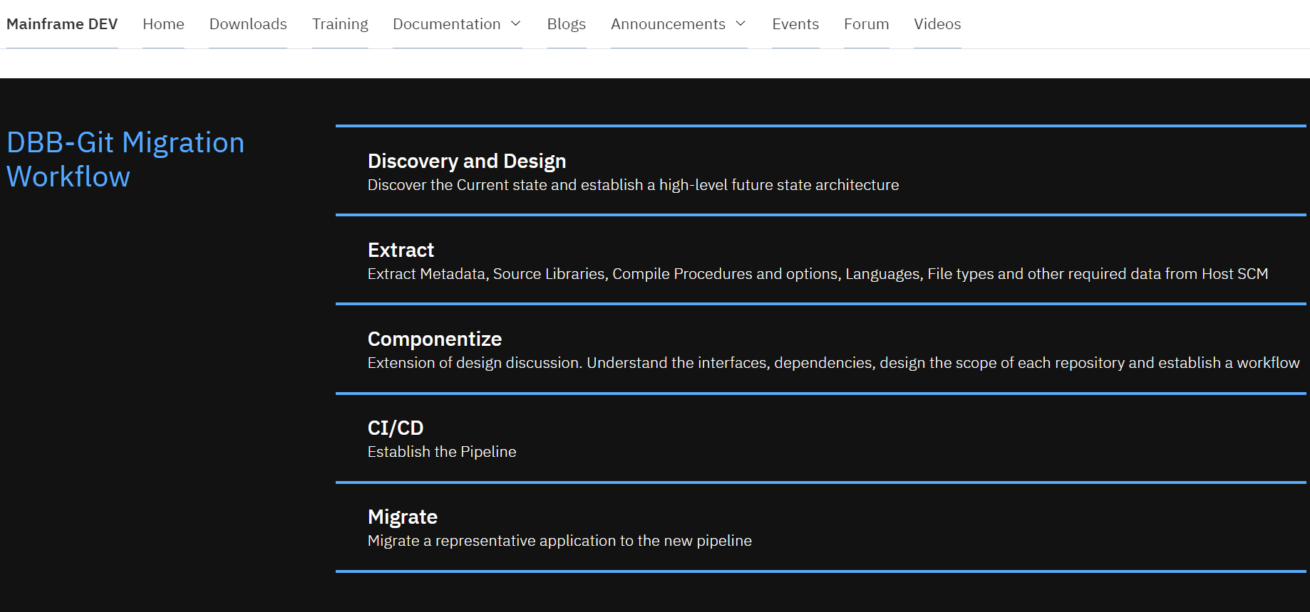
DevOps transformation with IBM’s DevOps Acceleration Program
Notes:
Value Stream Assessment – Executed by SWAT team, offering DevOps VSA Engagement, CI/CD Pipeline Mapping, POV Presentations
Training – Covering Idz, ADDI and CI/CD, it is delivering through Z DevOps Learning team as both instructor led Virtual training and online Self paced training
Deployment – Delivered through Deployment project office , offers upto 52 hours of remote assistance to help deploy IDz and ADDI as per best practices
Adoption – Delivered through DevOps Acceleration Team, the team will start with capturing your current state and based on requirements design your future state. Help with preparing scripts and deploy the future state solution and CI/CD workflow.

Slide 21
Thank You

